Slide 1
MATLAB and KeySight Scopes
Diego Sena and members
Summer 2023

Slide 2
Agenda
Goals and objectives
So What? why is this important?
Plan of Record
Test plan
Literature search and background

Slide 3
Goals and Objectives
Control the KEYSIGHT Scope with MATLAB
Analyze the bandwidth of the scope and scope cables

Slide 4
So What? Why is this important
To characterize the maximum frequency sampleable by the scope and scope cables

Slide 5
Plan of Record
What is your SDI? KeySight scopes
What does it mean to “work”: Compare Bandwidth of different scopes and cables and find their Nyquist frequencies.
Test plan- how will you validate that it “works”? Use a scope with a known bandwidth and compare the Nyquist cut off.
What is the killer app: Bandwidth analyzer
Examples of some of the actions you might take
A rough schedule: week by week until your presentation date, or Aug 11.

Slide 6
Test Plan
What are the specifications you will test to: what does it mean to “work?”
What will you measure
What are the tests you will do?
What is a measure of success?

Slide 7
Literature Search, Background

Slide 8
What was accomplished last week
Connected the computer and scope
Pull data from the scope
Plot data from the scope
Analyze data from the scope

Slide 9
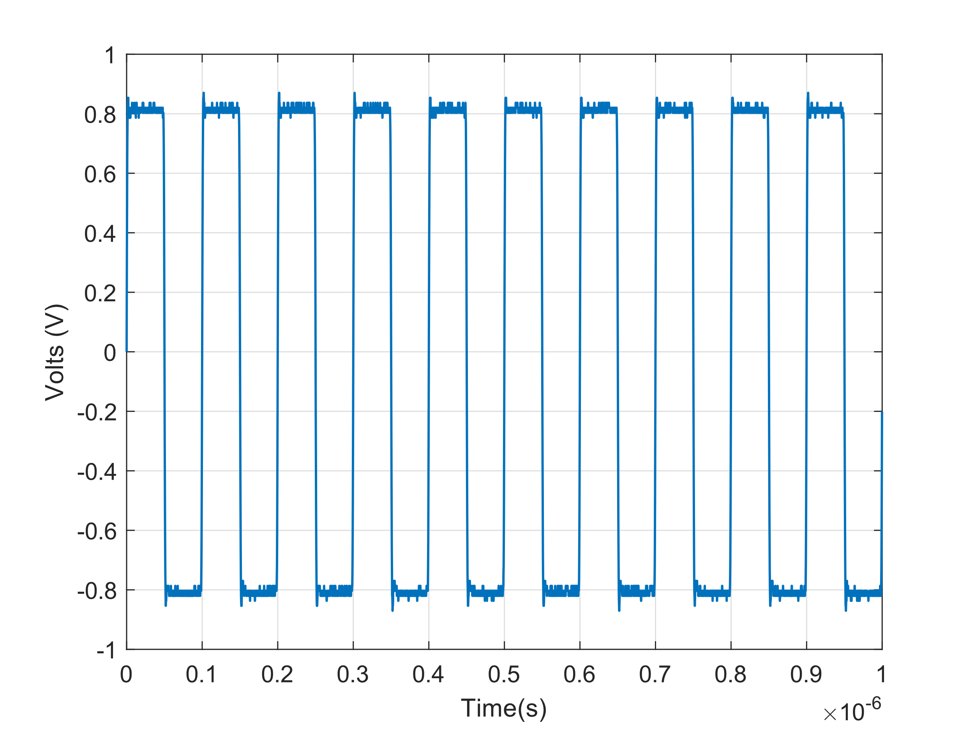
Square Wave From Scope

Slide 10
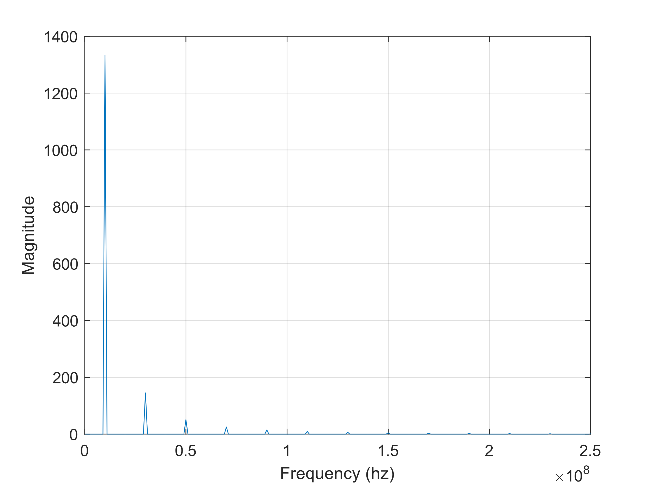
FFT of Square Wave

Slide 11
What is planned next week

Slide 12
Progress to the Goal

